Slide 1
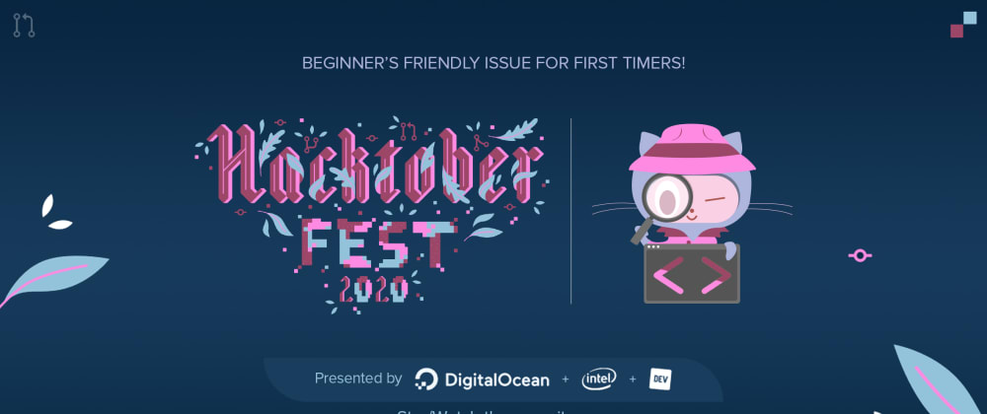
Git and Github
Open Hack Sprint 2020
Presented to you by,
-Gaurav Purswani

Slide 2
Git
Git is a version control system.
It’s a system that records changes made to files and folders in a project.
We can recall any specific versions(checkpoint or commit) of those files at any time.
Many people can easily collaborate on a project and add new features without messing with the main codebase.
*Version control system are systems that track changes and manage changes made to a digital asset.

Slide 3
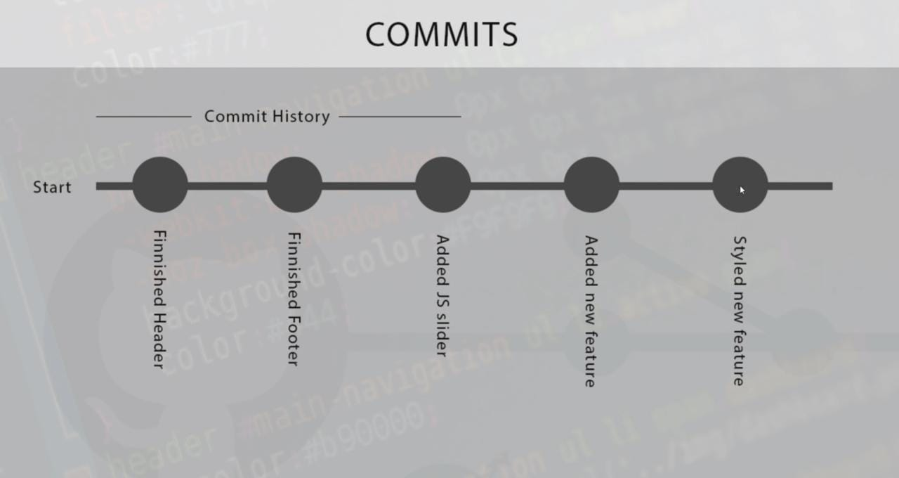

Slide 4
Github
Github is a web-based GUI which provides hosting for software development.
A user can share his/her code with other developers around the world.
They can also make any changes and re-upload them.
*GUI - Graphical User Interface

Slide 5
Creating Versions (checkpoints):
Initiating
:starting a git repository
Modifying
:Modifying the code with text editors.

Slide 6
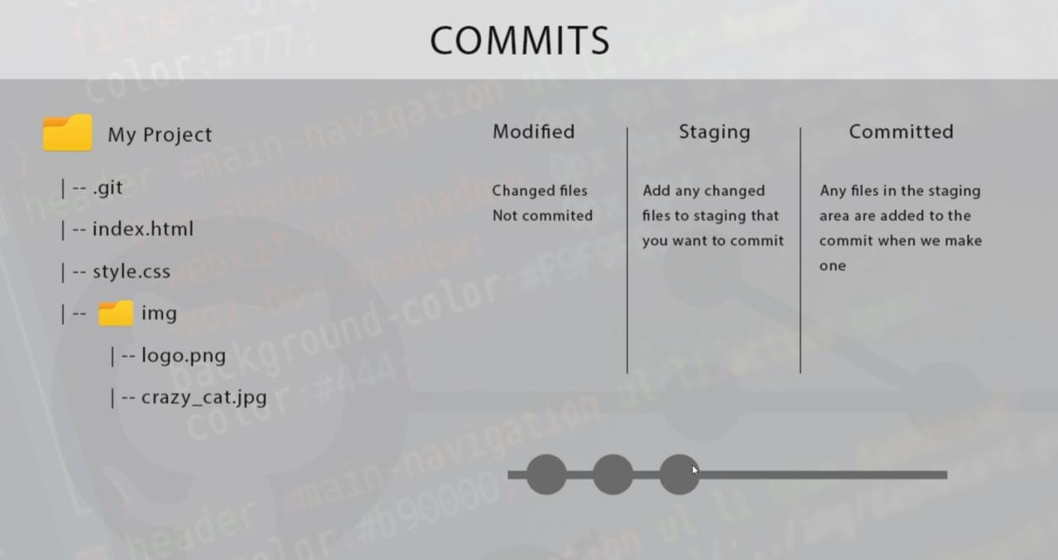

Slide 7
Contd.
Staging
:Telling the version control system to track files.
Committing
:Committing the changes to create a checkpoint.

